Slide 1
IT Seminar #11
Danish Day

Slide 2
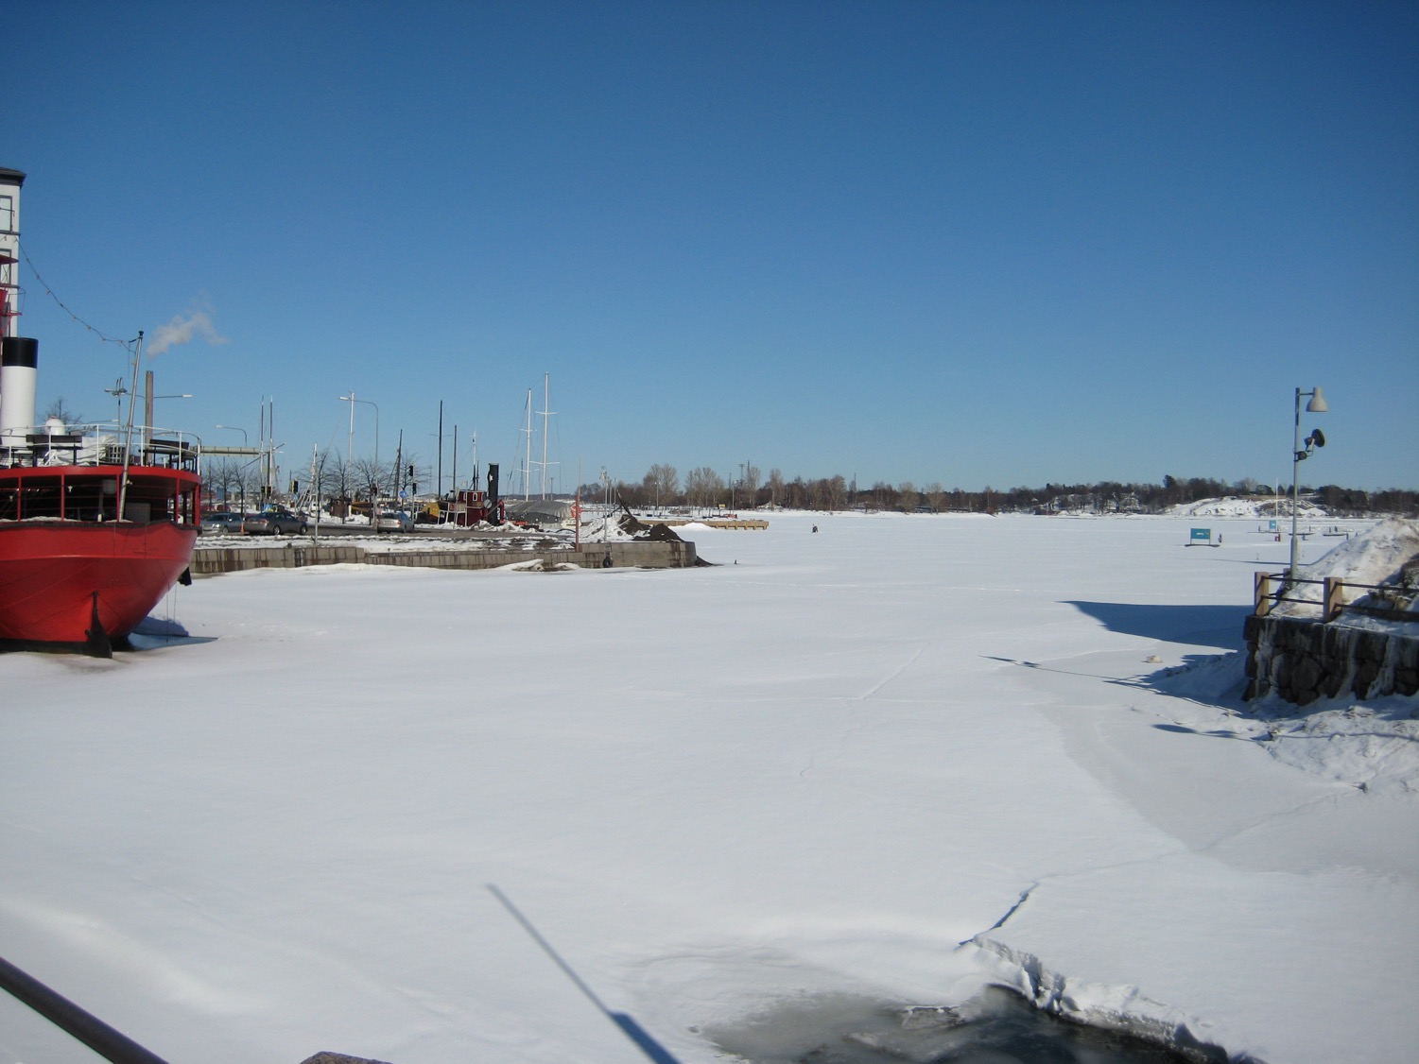
Notes:
2010 Helsinki

Slide 3
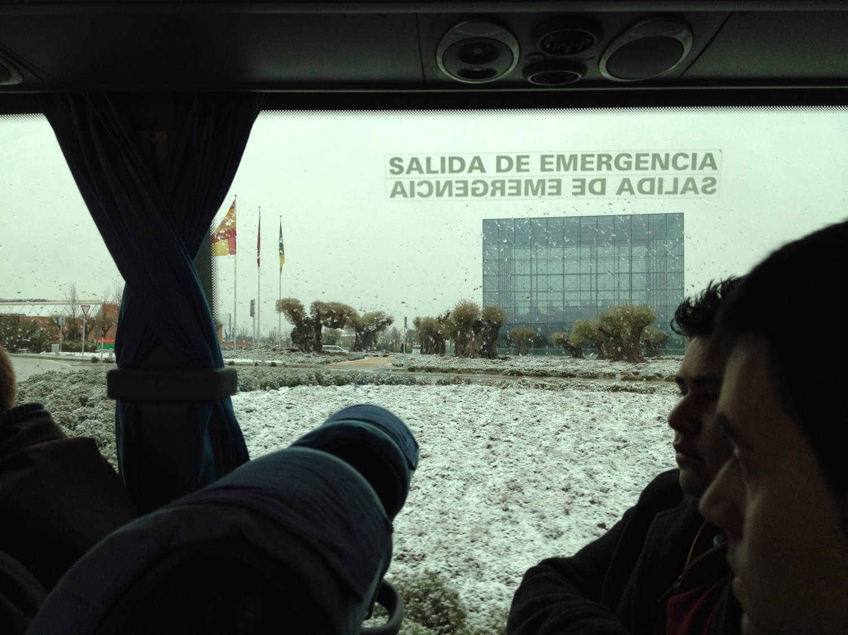
Notes:
2012 Madrid

Slide 4
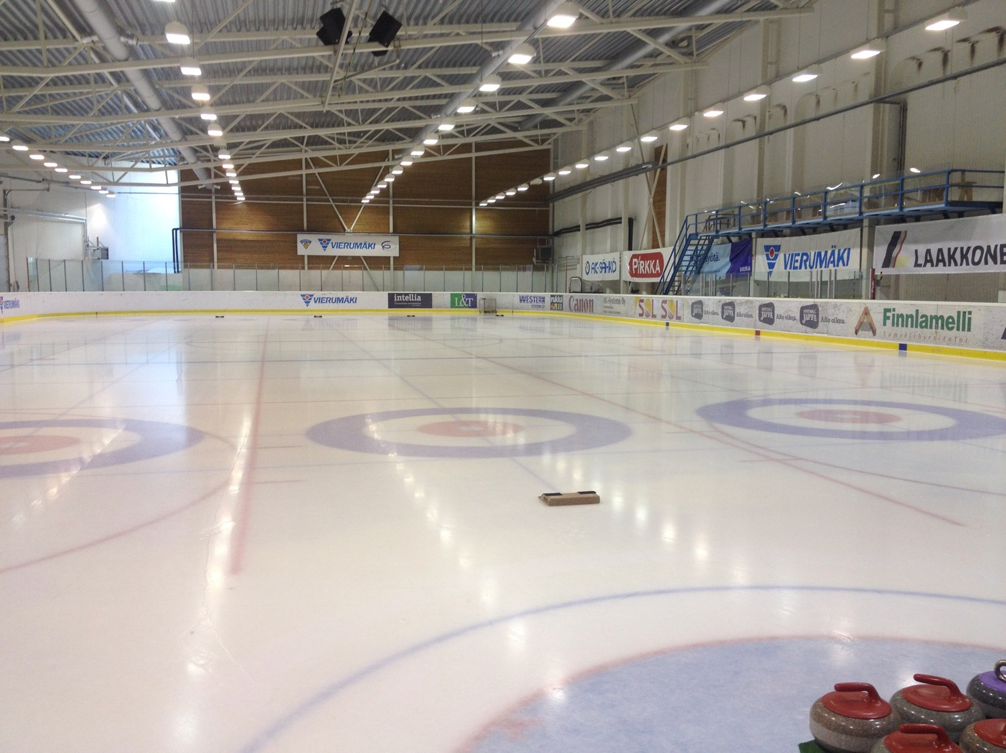
Notes:
2014 Helsinki

Slide 5
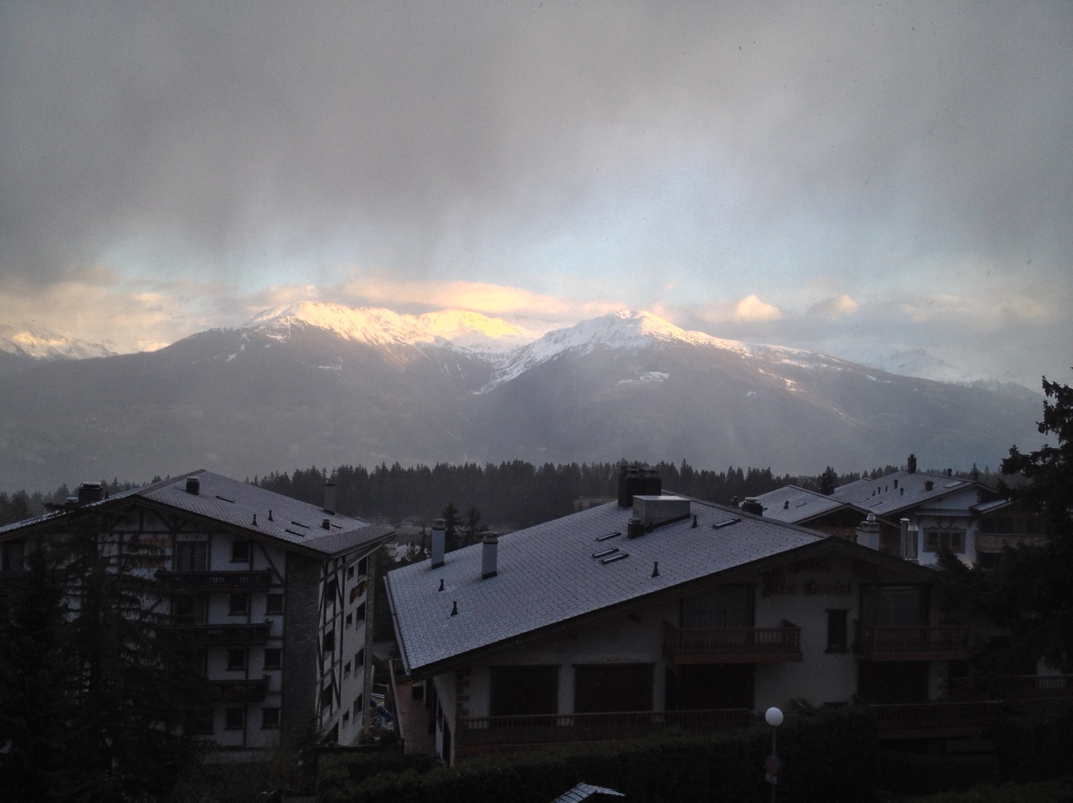
Notes:
2017 Sierre

Slide 6

Largest business academy in Denmark
5.800 full time students
7.200 part time students
380 employees
Five campuses in Copenhagen and Northern Zealand
Notes:
900 international students

Slide 7
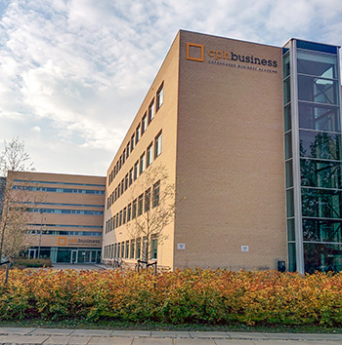
Lyngby campus
Computer Science
Multimedia
Marketing
Finance
Controller
Sport
Entrepreneurship
Bachelor top-ups
Notes:
900 international students

Slide 8

Denmark
Size: ¾ of EU
If we include Greenland
And goes back to about 1450
Status in 2017: ≈ 1% of EU
Size:
¾
of
EU
Dannebrog – the oldest national flag in use
Fell from Heaven in 1219 in Estonia when
Valdemar Atterdag was re-christening the Estonians
But we have …

Slide 9
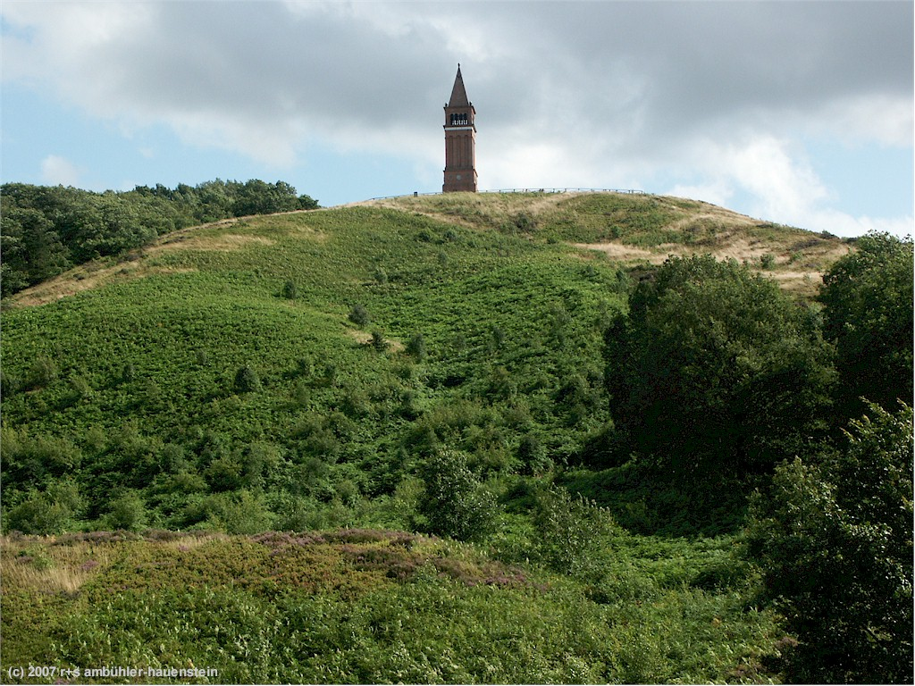
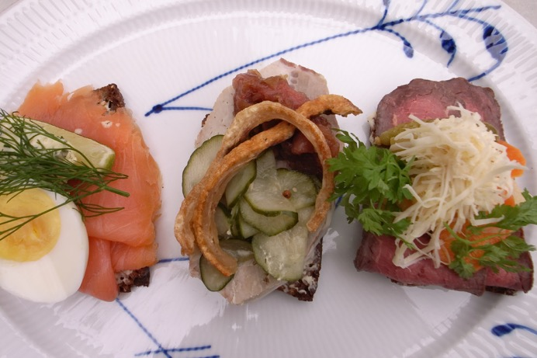
Sky mountain
Danish weather
147 m
But Yding Skovhøj is even higher
172,54 m including a bronze age burial mound
The land of “smørrebrød” open sandwiches Royal Copenhagen, Carlsberg, and Lego

Slide 10
Time
Zeit
Temps
Aika
IT Seminar 2017
Tid
Tiempo
Tempo

Slide 11

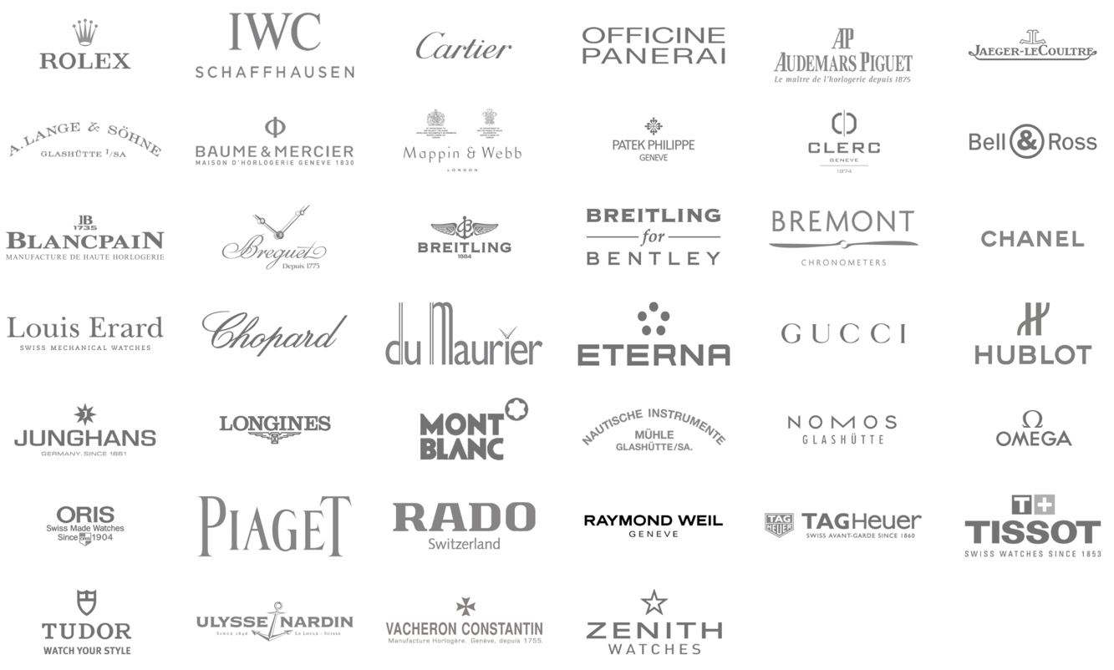
Talking about time in Switzerland

Slide 12
Talking about time in Switzerland
In Italy, for thirty years under the Borgias, they had warfare, terror, murder, and bloodshed, but they produced Michelangelo, Leonardo da Vinci, and the Renaissance.
In Switzerland, they had brotherly love, and they had 500 years of democracy and peace. And what did that produce?
No, the Cuckoo clock is from Swartzwald
And 500 years ago the Swiss army was feared through out Europe, the pope still has a Swiss Guard

Slide 13
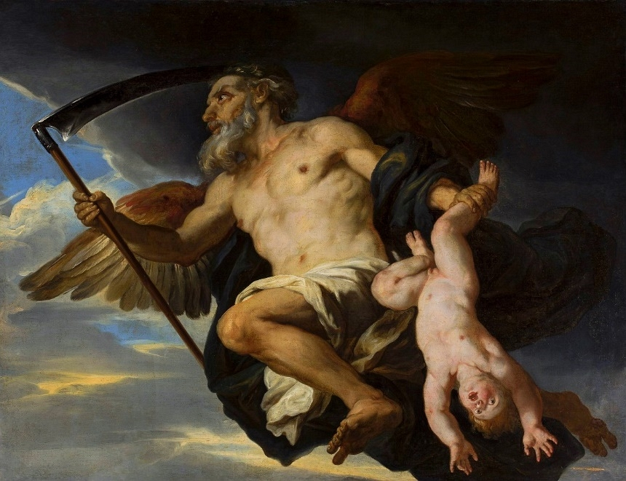
Χρόνος - Khronos
Father of
Chaos – Void
Grandfather of
Gaja – Earth
Tartarus – Hell
Eros – Love
Erebus – Darkness
Nyx – Night
Notes:
a 17th century depiction of Titan Cronus as "Father Time," wielding a harvesting scythe
Erebus and Nyx -> Hemera – Day and Aether – Heaven

Slide 14
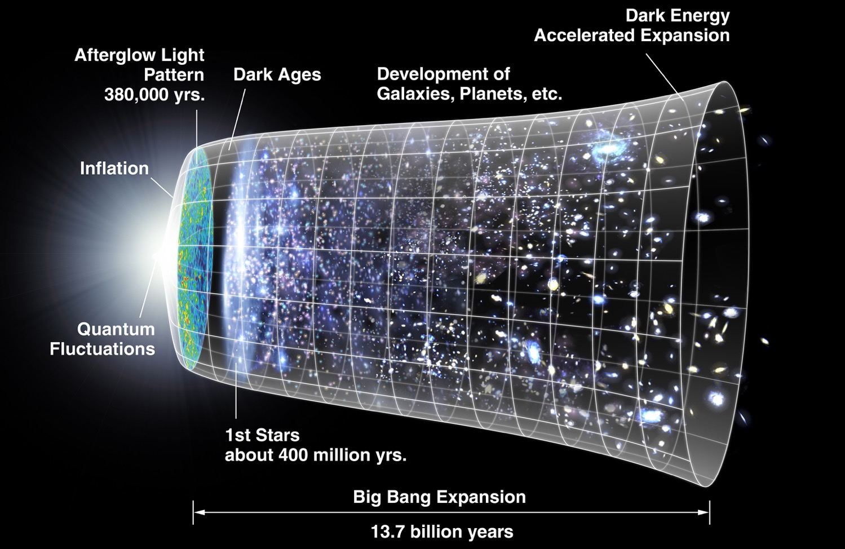
Big bang

Slide 15
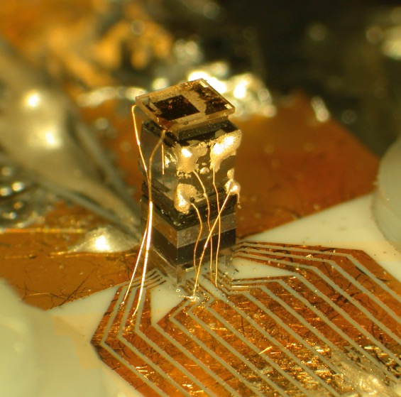
What is time
What clocks measure (physicist Albert Einstein)
A linear continuum of instants (philosopher Adolf Grünbaum)
What prevents everything from happening at once (physicist John Wheeler and others)
A continuum that lacks spatial dimensions (Encyclopaedia Britannica)
Just another spatial dimension
Have to obey the law of increasing entropy

Slide 16
What is time - seconds
1/86 400th of a mean solar day
The duration of 9.192.631.770 periods of the radiation corresponding to the transition between the two hyperfine levels of the ground state of the caesium 133 atom.
1/86 400th of any day
1 s/c ≈ 1/299.792.458 m ≈ 3,3356 nm
Notes:
The word "tropical" comes from the Greek tropikos meaning "turn".

Slide 17
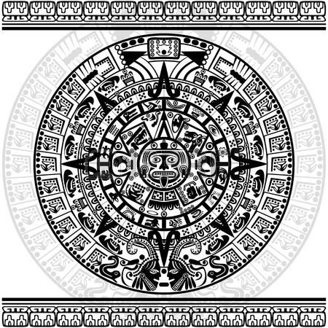
Calendar building blocks

Slide 18
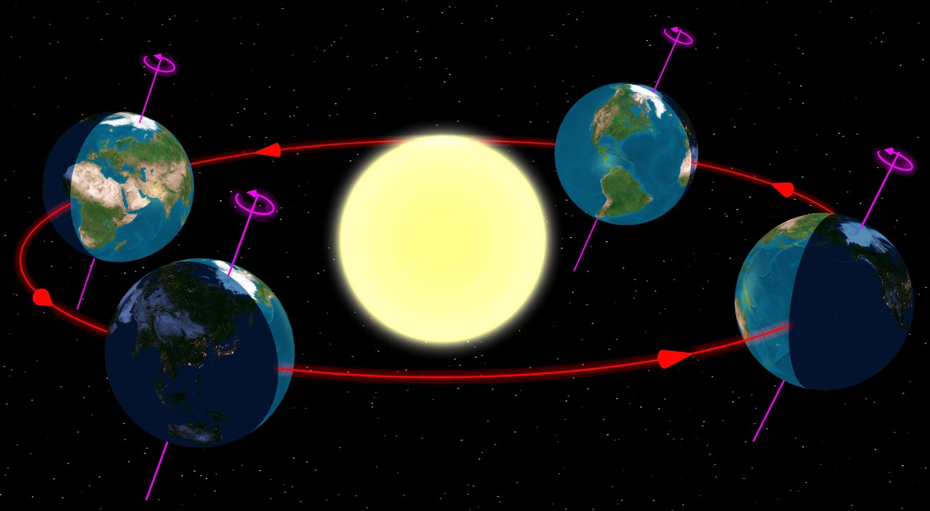
The Sun
At least until
Copernicus came along
Defines the day
Sun orbits the Earth exactly once a day
Defines the year
Earth orbits the sun every 365,256363004 days

Slide 19
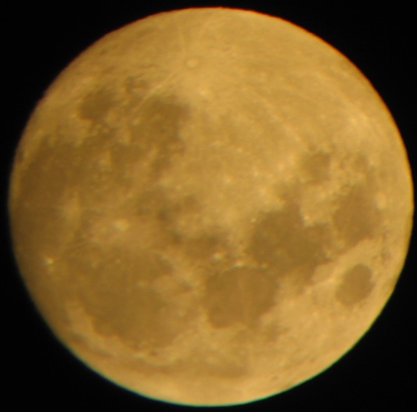
The Moon
Defines the month
27,321662 days per rotation w. respect to the Stars
29,530589 days per rotation w. respect to the Sun
Calendar months of 29 or 30 days makes more sense than 31 day months

Slide 20
Roman calendars
Romulus calendar had ten months and winter
Then January and February replaced winter
Julius Caesar introduces leap years in the
Julian Calendar
BC 46 is the longest year ever, with 445 days
A Julian year lasts 1 year, 11 minutes, and 14 seconds

Slide 21
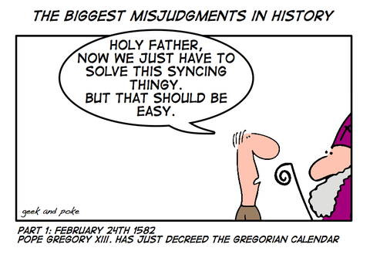
Gregorian Calendar

Slide 22
Gregorian Calendar
Spain:4 Oct 1582 → 15 Oct 1582
Switzerland
Catholic cantons: 1583, 1584 or 1597
Protestant cantons: 31 Dec 1700 → 12 Jan 1701
Denmark: 18 Feb 1700 → 1 Mar 1700
Finland: 17 Feb 1753 → 1 Mar 1753
Notes:
Finland
Erik Eriksson conquered (Christened) Finland as Valdemar Atterdag did with the Estonia,
1809 Russia conquers Finland
Then part of Sweden. (Note, however, that Finland later became part of Russia, which then still used the Julian calendar. The Gregorian calendar remained official in Finland, but some use of the Julian calendar was made.)
What about Sweden?
Sweden has a curious history. Sweden decided to make a gradual change from the Julian to the Gregorian calendar. By dropping every leap year from 1700 through 1740 the eleven superfluous days would be omitted and from 1 Mar 1740 they would be in sync with the Gregorian calendar. (But in the meantime they would be in sync with nobody!)
A Swedish almanac from February 1712.
Click on the image for more information.
So 1700 (which should have been a leap year in the Julian calendar) was not a leap year in Sweden. However, by mistake 1704 and 1708 became leap years. This left Sweden out of synchronisation with both the Julian and the Gregorian world, so they decided to go back to the Julian calendar. In order to do this, they inserted an extra day in 1712, making that year a double leap year! So in 1712, February had 30 days in Sweden.
Later, in 1753, Sweden changed to the Gregorian calendar by dropping 11 days like everyone else.

Slide 23
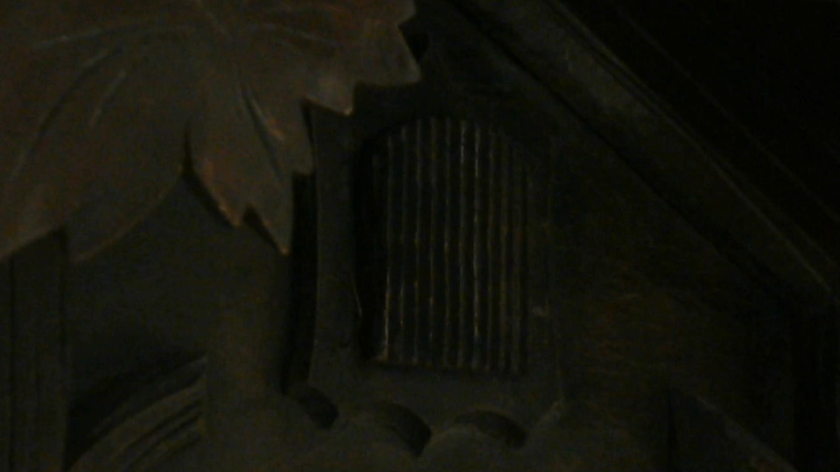

Slide 24
1923 Julian Calendar strikes back
Leap year when
divisible with 4 and
not divisible with 100
or not 200 or 600 when divided by 900
Calendar | Introduced | Days per year | Error per year
Revised Julian | 1923 | 365,242222 | < 1s
Gregorian | 1582 | 365,242500 | ≈ 2s
Julian | -45 | 365,250000 | ≈ 13s
Roman | - | 365,000000 | ≈ 6 hours

Slide 25
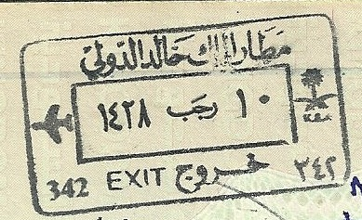
Islamic calendar
Starts when Muhammad and his followers migrated from Mecca to Medina and established the first Muslim community (AD 622).
Months are 29 or 30 days long depending on the moon cycle.
10 Rajab 1428 / 24 July 2007

Slide 26
Chinese Calendar
Twelve animals (zodiacs)
Five materials
Twelve or thirteen months of 29 or 30 days
353/355 days per normal year
383/385 days per leap year

Slide 27
Week and day numbers
Sunday or Monday as first day of week
Early Christians observed the seventh day with prayer and rest, but they also gathered on the first day. By the 4th century, Christians were officially observing the first day, Sunday, as their day of rest, not the seventh.
Which week is the first US/EU
ISO-8601: The first week of the year is the week that contains that contains the years first Thursday. Week starts with Monday
The week with January 1st is week one
The first full week is week one

Slide 29
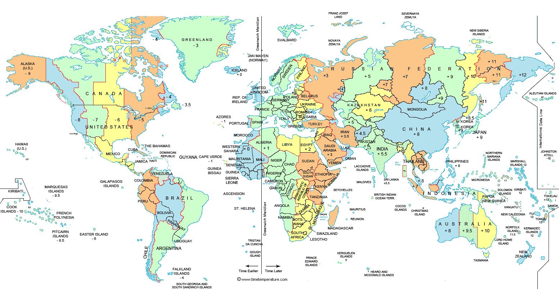
Time zones
Notes:
A localized solution for a global world
The date line

Slide 30
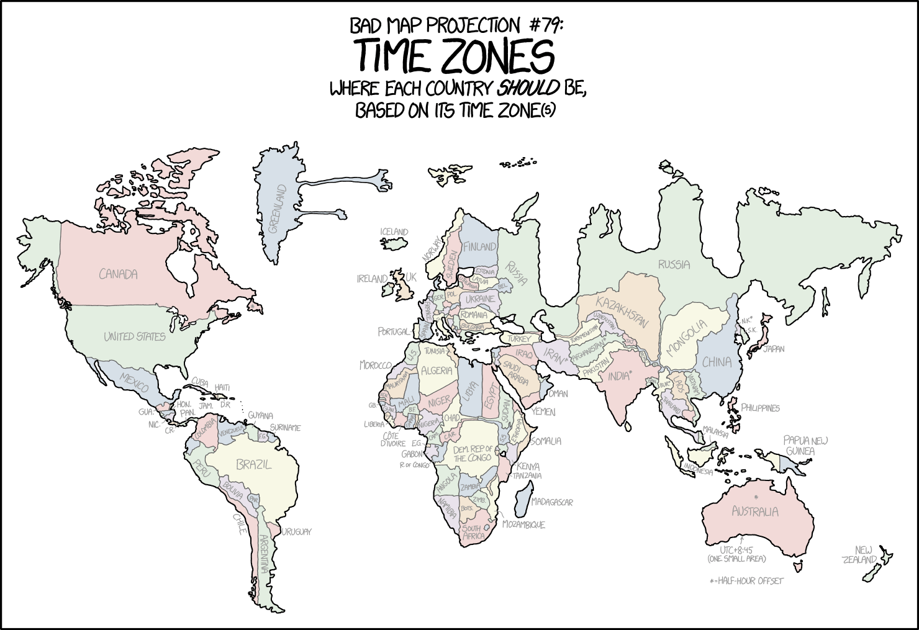

Slide 31
UTC
Coordinated Universal Time
Temps universel coordonné
Not the same as GMT – guess why!

Slide 32
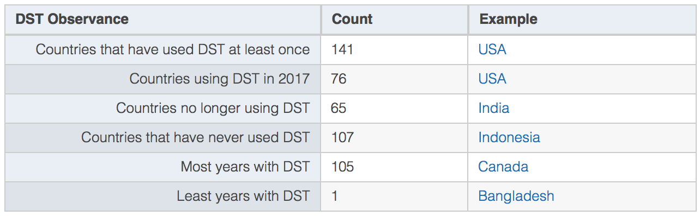
Daylight saving time
76 countries uses DST
They do not agree on starting and ending time
Not even within the same country (Mexico)
Normally 1 hour, but Lord Howe Island uses ½ hour

Slide 33
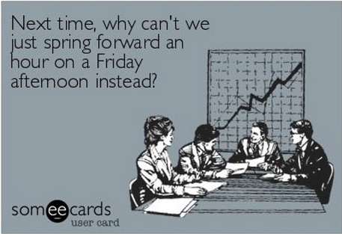
DST - does it work?
No, it doesn’t save energy
When Indiana decided to introduce DST in 2006, a study found that the measure actually increased energy use in the state.
Can make people sick
Especially when starting
Less artificial light used
Make people go more outdoors
Decreases traffic incidents

Slide 34
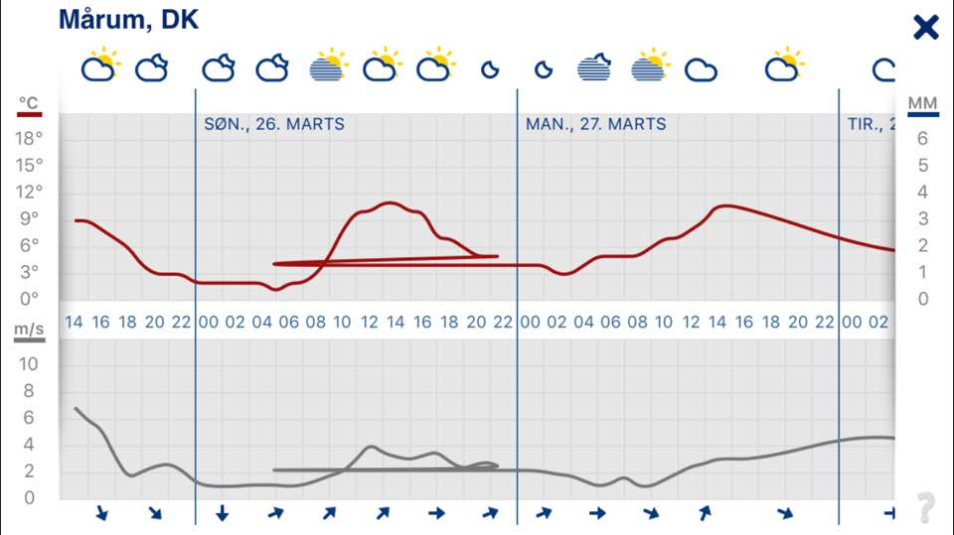

Slide 35
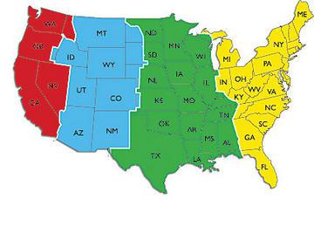
Winter USA

Slide 36
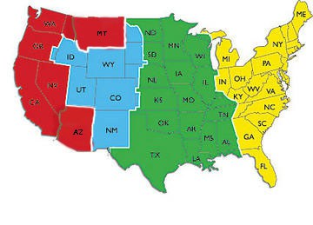
Summer USA (from 2018)
Notes:
Montana
Navajo does not
Hopi does

Slide 37
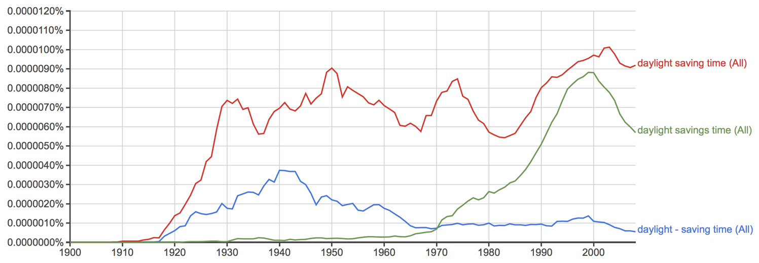
We don’t even agree on the spelling
Source:
https://books.google.com/ngrams/

Slide 39
Time formats
yyyy-mm-dd and dd-mm-yyyy
mm/dd-yyyy
mmm dd. yyyy
dd mmm yyyy
am/pm
Automatic detection of date and time formats
11/14-1959 or 14-11-1959 no problem
01/04-1960 or 04-01-1960 problem

Slide 40
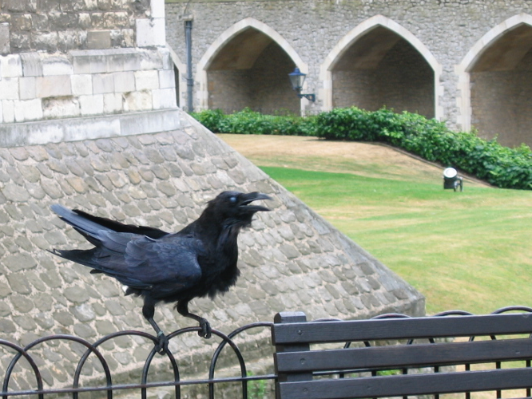
Time for a short break

